Slide 1
Design of Data Warehouse & Business Intelligence for a Hospital
Group 8
Name: Hitarth Jain, Aishwarya Nair, Abhishek Panchal, Vishva Patel, Ravikiran Sriram
Course: MIS 633
Professor - Joseph Morabito

Slide 2


Overview
High Level Design
Candidate Subject Area
Candidate Fact
Bus Architecture
Sequence of Construction
Development of Data Mart
Logical Dimension Model
Star Schemas
Conformed Dimensions
Slowly Changing Dimensions
Transformation Rules
Aggregate Table
OLAP Cube
Role Specific BI Portal
Conclusion

Slide 3
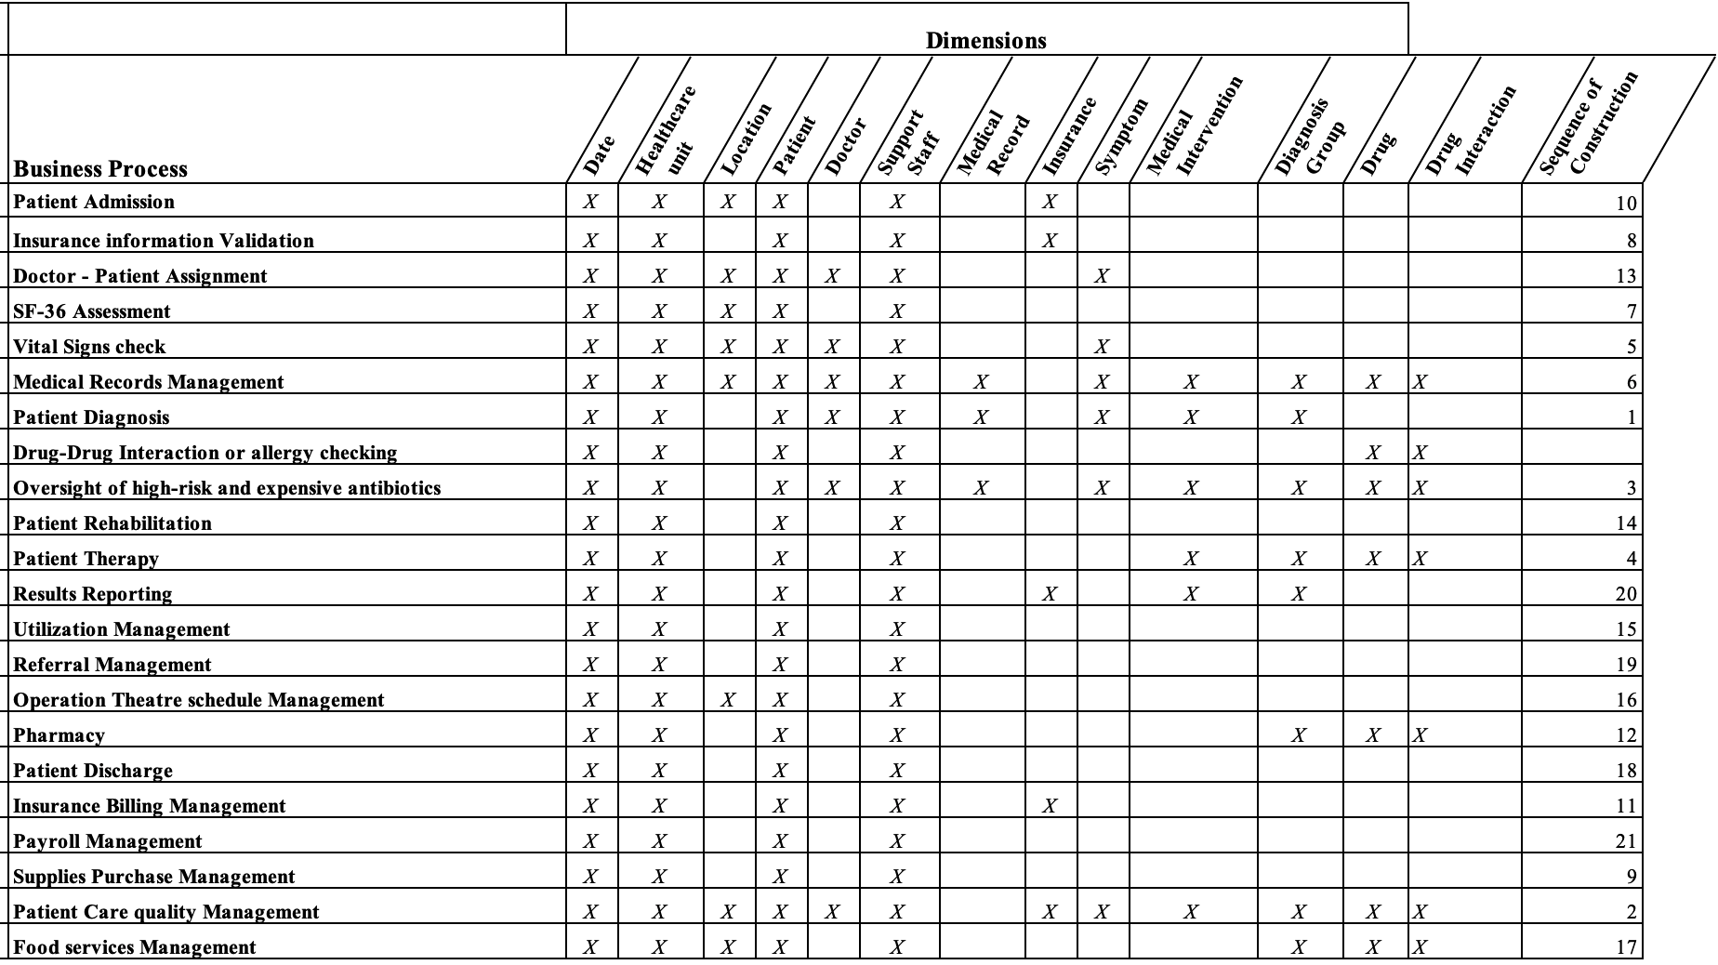
Bus Architecture
Healthcare Organization Bus Architecture

Slide 4
Dimensional Modelling
Here, we are focusing on the day to day operation of the most important offices in a hospital ie the reception desk, the pharmacy department and doctor’s clinic.
The star schema design for reception desk includes brief information about the patient, as in which doctor is the patient appointed, the date & timing of the appointment, payment, insurance etc.
The star schema design for a doctor’s clinic would be much more focused than the reception. Here, the schema would have much more detailed information about the patient like medical records, any diagnosis given, which medication is the patient taking etc.
The star schema for the pharmacy department would be completely different than the above two. It will have the information about all the drugs available in the pharmacy and which drugs are given to which patient. This kind of schema will help the department in analytics.

Slide 5
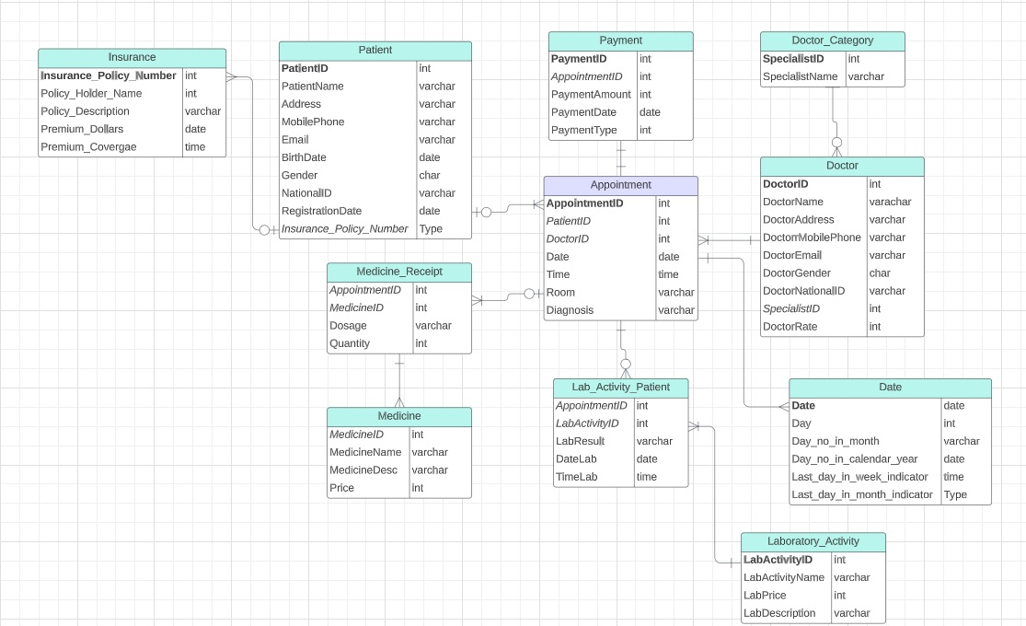
Reception Star Schema

Slide 6
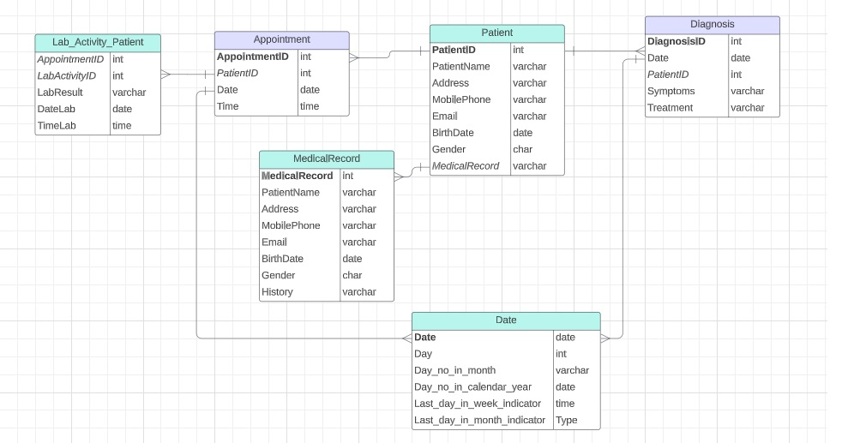
Doctor Star Schema

Slide 7
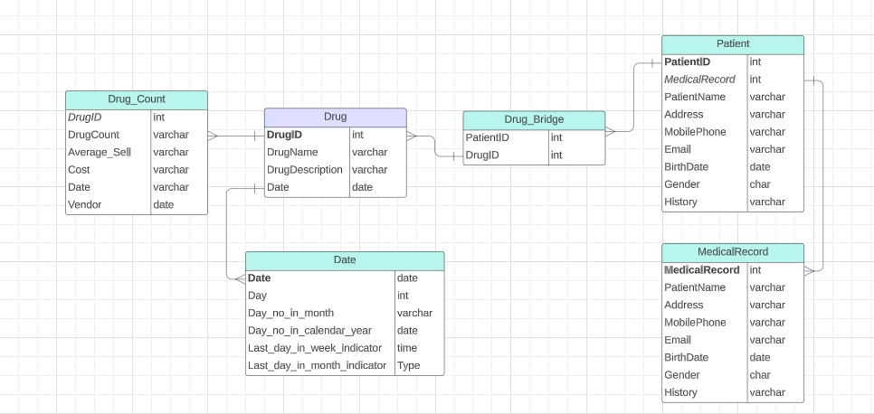
Pharmacy Star Schema

Slide 8
Conformed Dimensions
A Conformed Dimension in the context of data warehousing denotes a dimension that retains identical significance and content across various data marts or segments within a data warehouse. It upholds uniformity in its structure, definitions, attributes, and hierarchies across the entirety of the data warehouse environment.
In Our Dimension Modelling, We have the following Conformed Dimensions:
Patient Dimension
Doctor Dimension
Medical Record Dimension
Date Dimension

Slide 9
Dimension Attribute Detailed Description:Diagnosis Dimension
Name | Description | Cardinality | Slow Changing Dimension Policy | Sample Values
Diagnosis ID | Unique identifier for each diagnosis. | 1-64000 | Type-0(Not Updatable) | 1001,1002
Date | Date of the diagnosis | 2000-01-01 to 2023-31-12 | Type-0(Not Updatable) | 2023-12-20, 2023-10-10
Patient ID | Identifier for the patient associated with the diagnosis | 1-64000 | Type-0(Not Updatable) | 5001,5002
Symptoms | Symptoms associated with the diagnosis | 1-100 | Type-1(Updatable) | Fever, Cough
Treatment | Treatment given for the diagnosis | 1-250 | Type-1(Updatable) | Antibiotics,Rest

Slide 10
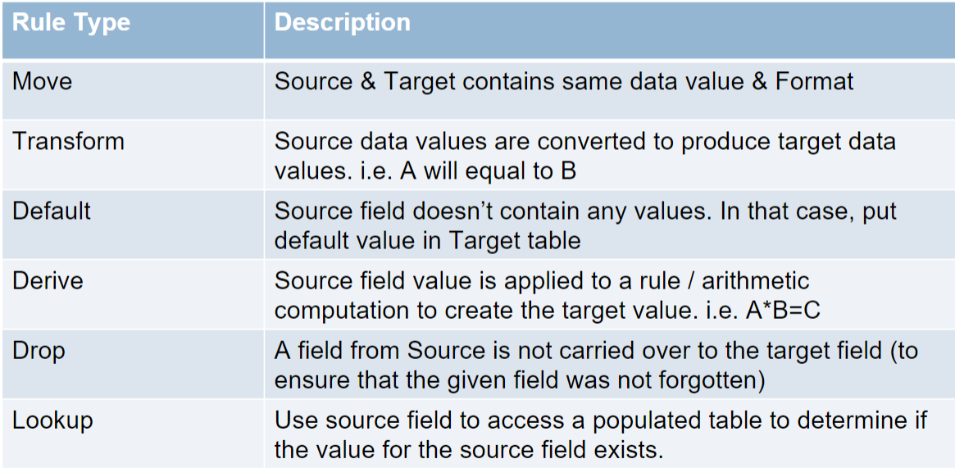
Transformation Rules

Slide 11
Aggregate Table
Comprehensive healthcare dataset with patient demographics, conditions, admissions, and billing.
Creation of an aggregate table to distill key patient-related metrics.
Categorization of data by gender and medical condition.
Calculation of average billing amounts and patient ages by admission type.
Streamlined data presentation for enhanced accessibility and insight extraction.
Facilitates the construction of an OLAP cube for more complex, multidimensional analysis.
Supports informed decision-making in healthcare management and policy.
Enables a nuanced understanding of diverse patient data for better service delivery.

Slide 12
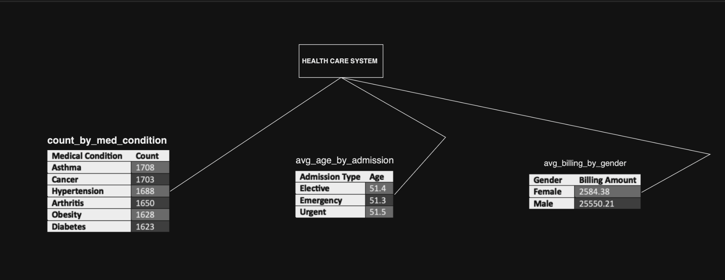
Aggregate Table
Medical Condition Counts:
Lists common medical conditions like Asthma, Cancer, Hypertension, Arthritis, Obesity, and Diabetes.
Shows the count of patients for each medical condition.
Average Age by Admission Type:
Breaks down average patient age according to the type of admission: Elective, Emergency, and Urgent.
Demonstrates little variation in age across admission types, with ages hovering around 51 years.
Average Billing Amount by Gender:
Compares the average billing amounts between Female and Male patients.
Indicates a slight difference in billing amounts with females averaging $25,484.38 and males $25,550.21.

Slide 13
OLAP Cube
The OLAP cube encapsulates detailed healthcare billing data across multiple dimensions.
It includes dimensions such as Gender, Medical Condition, and Admission Type.
The cube calculates the average billing amount for each category intersection.
Enables quick, multifaceted analysis and comparison of billing patterns.
Facilitates understanding of cost implications across different patient groups.
Serves as a powerful analytical tool for healthcare financial management.
Assists in optimizing healthcare services and resource allocation.

Slide 14
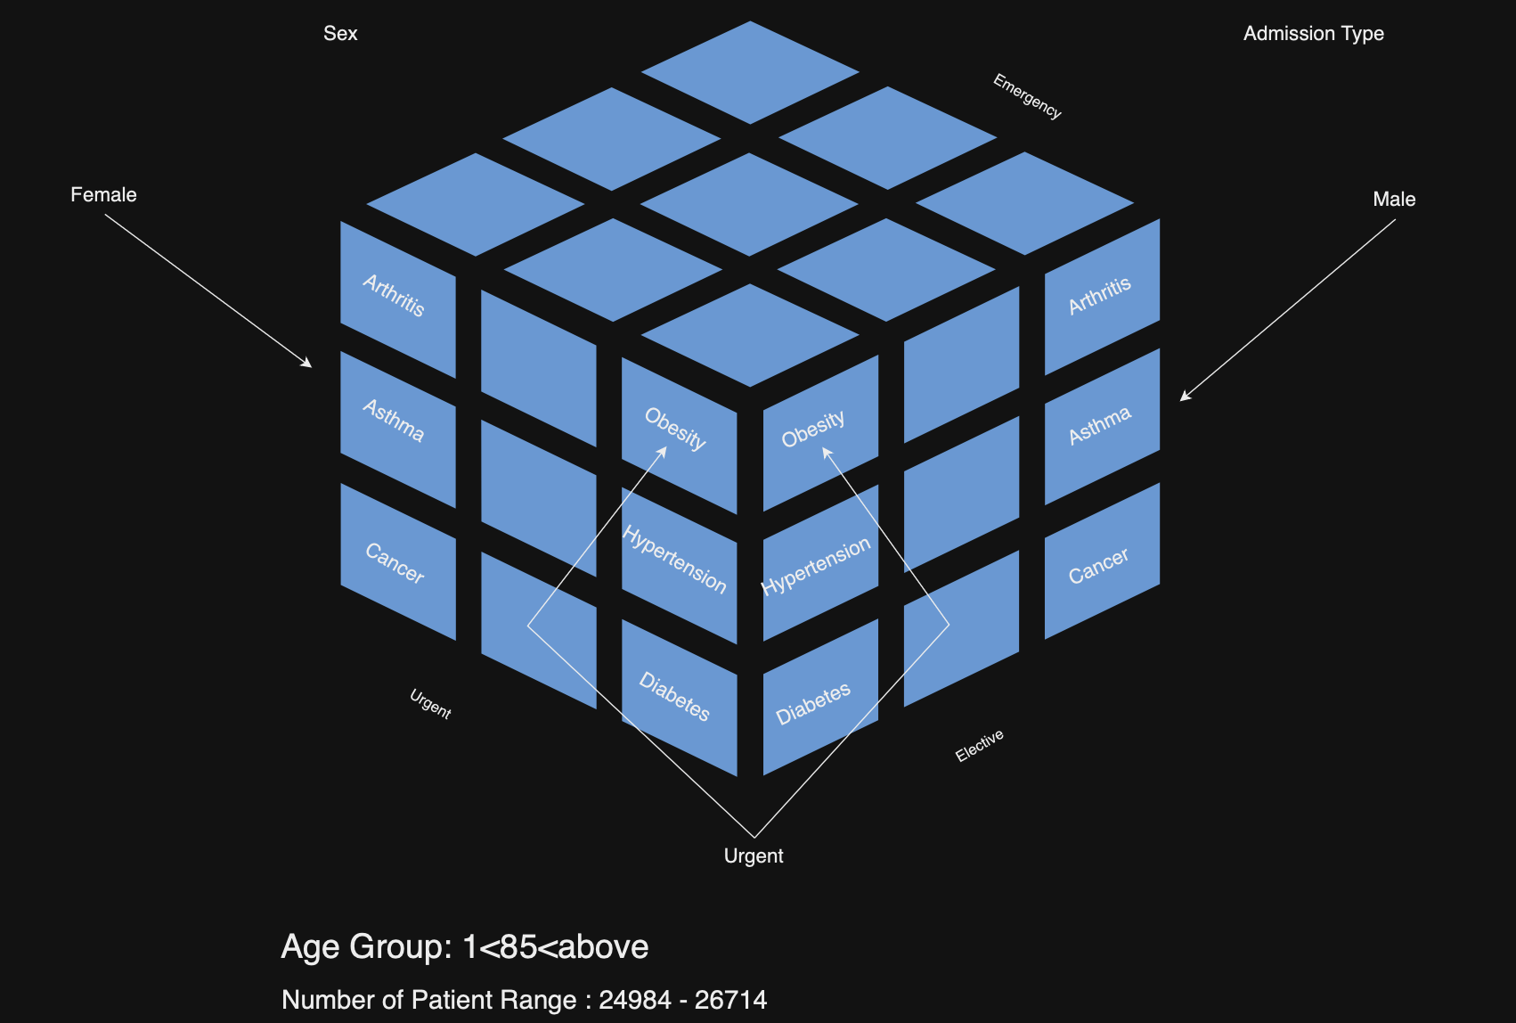
OLAP Cube

Slide 15
Role Specific Reports
Users | Reports
Doctor | Ad hoc report, Detailed report
Hospital Managers | OLAP Slice Cube
Support Staff | Standard Report
Pharmacy Staff | Ad hoc report, Detailed report

Slide 16
Tableau Visualization

Slide 17
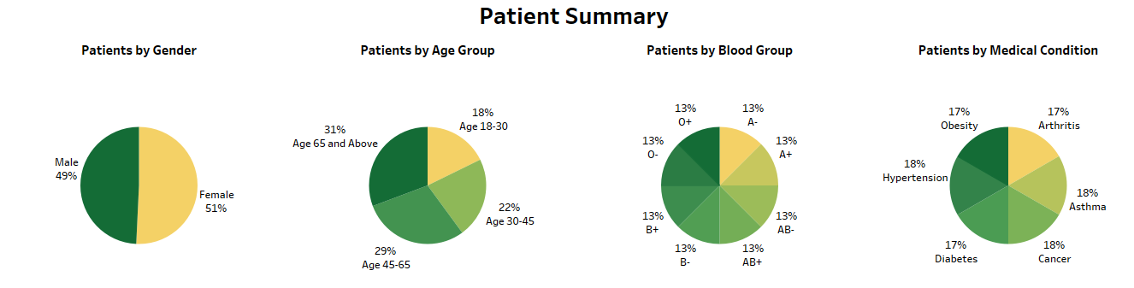
Patient Dashboard (1/3)
Insights
Age 45 and above constitute 60% of the overall patients
The distribution of patients is evenly spread across each blood group category.
The percentage of patients for each specific medical condition is uniform.

Slide 18
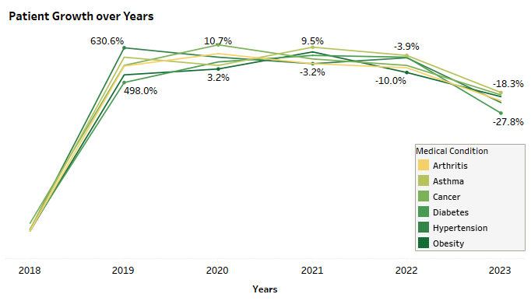
Patient Dashboard (2/3)
Insights
Incomplete data collection for 2018 and 2023 results in a skewed percentage difference at these points.
The patient population experiencing arthritis exhibits a declining trend each year.
The patient population with diabetes shows a consistent upward trend each year.

Slide 19
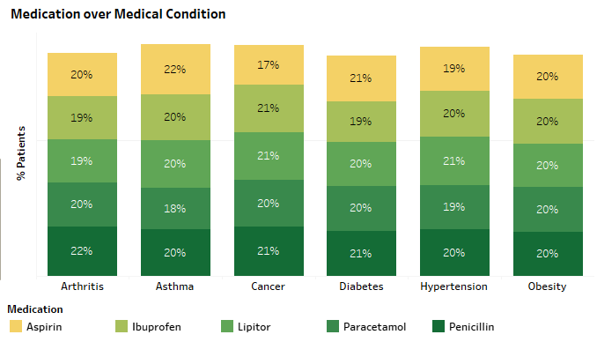
Patient Dashboard (3/3)
Insights
Aspirin is the least consumed medication by patients with Cancer medical condition.
While the consumption of medicines is uniform across various medical conditions, there is a slight preference for Penicillin among patients across all conditions.

Slide 20
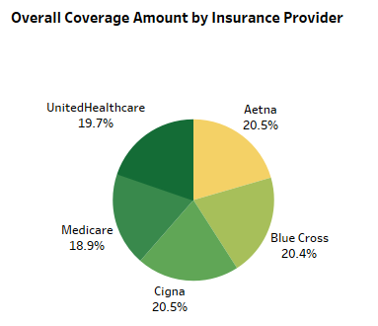
Insurance Providers Dashboard (1/4)
The subsequent sections delve into the analysis of coverage provided by various insurance providers.
Insights
Medicare ranks as the insurance provider with the least comprehensive coverage.
Aetna and Cigna stand out for offering the most extensive coverage.

Slide 21
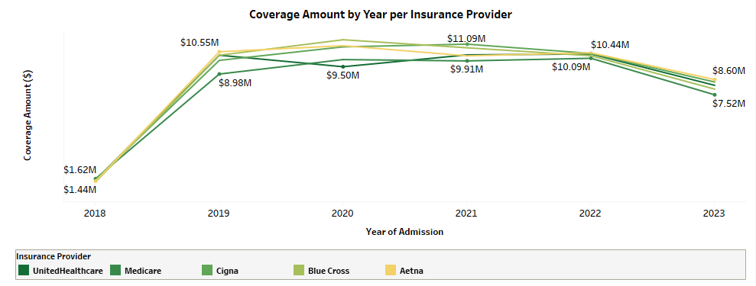
Insurance Providers Dashboard (2/4)
Insights
In 2020, all insurance providers, except UnitedHealthcare, witnessed an increase in coverage.
Medicare Insurance maintained consistent coverage levels throughout the years.

Slide 22
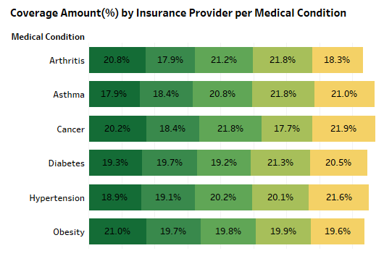
Insurance Providers Dashboard (3/4)
Insights
UnitedHealthcare provides the highest coverage for patients with the medical condition of Obesity.
Medicare consistently offers the least coverage across all medical conditions.
BlueCross offers the highest coverage for patients dealing with medical conditions such as Arthritis, Asthma, and Diabetes.

Slide 23
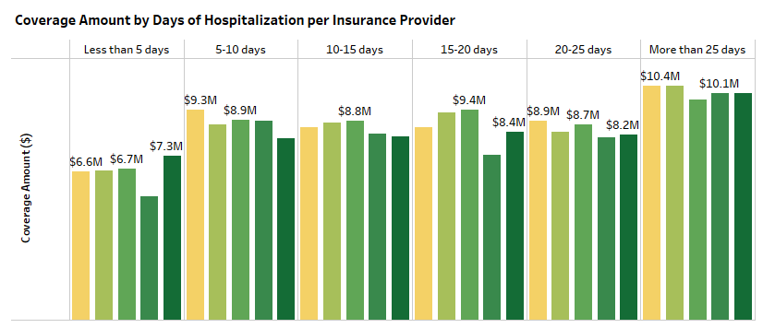
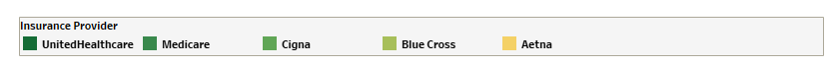
Insurance Providers Dashboard (4/4)
Insights
Medicare Insurance stands out as one of the less comprehensive insurance providers, particularly for hospital stays lasting fewer than 5 days or falling within the 15-25 day range.
UnitedHealthcare Insurance is more effective than its counterparts for hospital stays lasting less than 5 days.
Aetna Insurance provides the most comprehensive coverage for hospital stays exceeding 20 days.

Slide 24
Conclusion
The data warehouse we've constructed, centered around essential facts like Appointments, Doctor details, Pharmacy records, aims to facilitate convenient accessibility for various user groups—ranging from Doctors, Patients, Hospital Managers, Quality Care Managers, Risk Analysts, to Support Staff. This accessibility allows them to perform thorough analyses and make informed decisions, thereby delivering substantial value within the healthcare domain.

